Slide 1
Protecting Customer Data: Strategies for Online Business
Mitigating Risks and Ensuring Security
Sam Mendez, Gavin Leonard, and Eshan Singh

Slide 2

Why Customer Data Protection Matters
Importance of data security in online business:
Builds customer trust and loyalty.
Prevents financial losses from data breaches.
Ensures compliance with legal regulations (e.g., GDPR, CCPA).
Overview of risks associated with data breaches:
Financial losses.
Reputational damage.
Legal consequences.

Slide 3

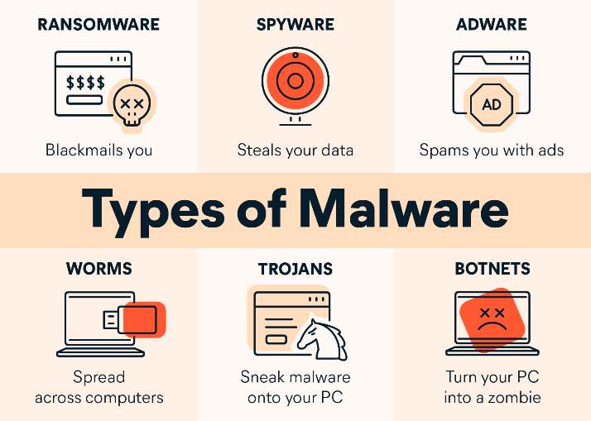
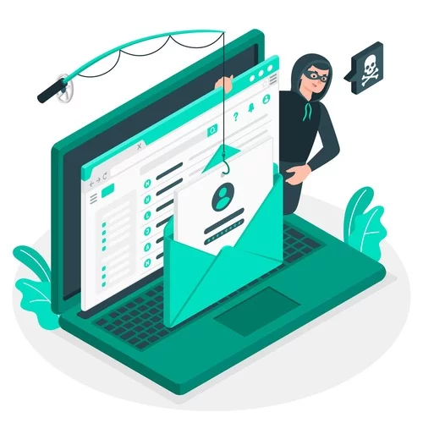
Understanding the Threat Landscape
Common Threats:
Hacking: Unauthorized access to systems to steal or manipulate data.
Phishing: Deceptive attempts to obtain sensitive information through fraudulent emails.
Malware: Malicious software designed to disrupt, damage, or gain unauthorized access to systems.
Recent Data Breach Example: Capital One (2019) and T-Mobile (2022) data breach had affected over 100 million of customer accounts exposing personal information.

Slide 4

Implementing Strong Password Policies & Encryption
Importance of Strong Passwords:
Characteristics of strong passwords: At least 12 characters long, mix of uppercase, lowercase, numbers, and special characters. Ex: P@sswOrd!247
Password Managers: Securely stores and generates strong passwords, reduces the risk of password reuse.
Two-Factor Authentication (2FA): Adds an extra layer of security, requiring a second form of verification.
Types of Encryption:
Data-at-rest: Encryption of stored data. Example: Encrypting files on a hard drive.
Data-in-transit: Encryption of data as it travels across networks.
How Encryption Works:
Encryption algorithms: Transform data into unreadable formats.
Use SSL/TLS for secure communications, encrypt sensitive files and databases.

Slide 5


Securing Your Network & Conducting Security Audits
Firewalls and Antivirus Software:
Firewall: Monitors and controls incoming and outgoing network traffic, blocks unauthorized access while permitting legitimate communications.
Anti-Virus Software: Detects and removes malware, regular updates protect against the latest threats.
Secure Wi-Fi Networks:
WPA2/WPA3: Provides stronger data security for wireless networks, protects against unauthorized access.
Regularly Updating Router Firmware: Ensures the latest security patches and features, reduces vulnerabilities.
Input Validation:
Input encoding: Metacharacters are encoded and then processed as regular characters by database
Positive pattern matching: Focuses on whitelisting valid input rather than blacklisting invalid input
Why Conduct Audits?
Detect weaknesses in security practices and infrastructure, helps prevent potential breaches.
Adheres to legal requirements and industry standards, avoids fines and legal penalties.
Steps to Perform an Audit:
Internal vs. external audits: Internal audits conducted by your staff, external audits by third-party experts for an unbiased assessment.
Regular updates and patches: Apply security patches promptly, keep all software and systems up to date.

Slide 6

Educating Employees & Developing an Incident Response Plan
Educating Employees:
Importance of Employee Training:
Recognizing phishing attempts: Identifying suspicious emails and links, reporting phishing attempts to IT.
Safe internet practices: Avoiding unsafe websites, not downloading untrusted software.
Ongoing Education Programs:
Regular workshops: Training sessions on the latest security threats and best practices, hands-on exercises for recognizing and responding to threats.
Up-to-date training materials: Providing employees with current resources, ensuring all staff are informed about new security policies.
Developing an Incident Response Plan:
Why You Need an Incident Response Plan:
Minimizing damage during a breach: Quickly containing and mitigating the impact, preserving evidence for analysis.
Key Components of an Incident Response Plan:
Identification: Detecting and identifying the nature of the incident.
Containment: Isolating affected systems to prevent further damage.
Eradication: Removing the cause of the incident (e.g., malware).
Recovery: Restoring affected systems and data from backups.
Lessons Learned: Analyzing the incident to improve future response strategies.

Slide 7

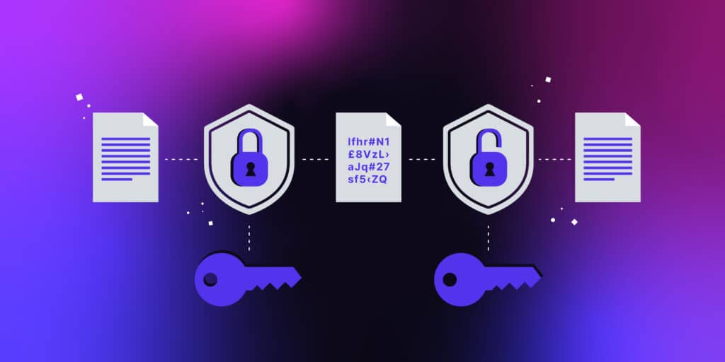
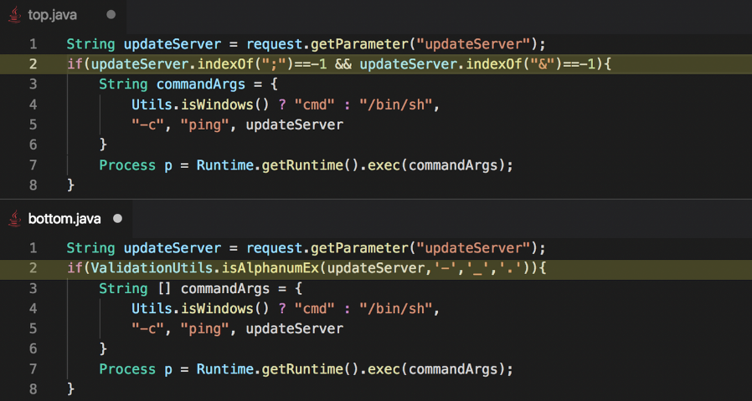
Recap and Final Thoughts
Password policy enforcement
Implementation of MFA
Encryption of data at rest, in transit and in processing
Securing network via firewalls, antivirus software, and firmware updates
Periodic security audits and assessments
Employee online safety education and training programs
Development of comprehensive incident response plans
Hardening web applications via input encoding and positive pattern matching

Slide 8

Thanks For Listening

